Slide 1
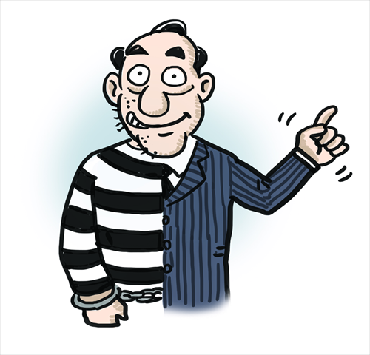
The political parties have committed
the biggest crime EVER in Australia
BUT… HOW?
They have stolen a whole Continent,
All our Mineral Riches,
and Enslaved everyone.

Slide 2


Although they did much more, these are the 4 major steps they took:
18 December 1959: The Parliament took control of the Governor General by removing the Royal Signet on the GG’s appointment letter (Letters Patent) from the Queen
= TREASON!
Step 1
… and replaced it with the kangaroo and emu Parliamentary Function Seal
= No Crown Authority!
= TREASON!

Slide 3

1966: The Australian government wanted to borrow millions of dollars from the US and International banks… but the banks made 2 demands…
1: The Parliament took control of our money, changing from our Pounds, as required in the Commonwealth of Australia Constitution Act 1901, to US dollars.
Step 2

Slide 4
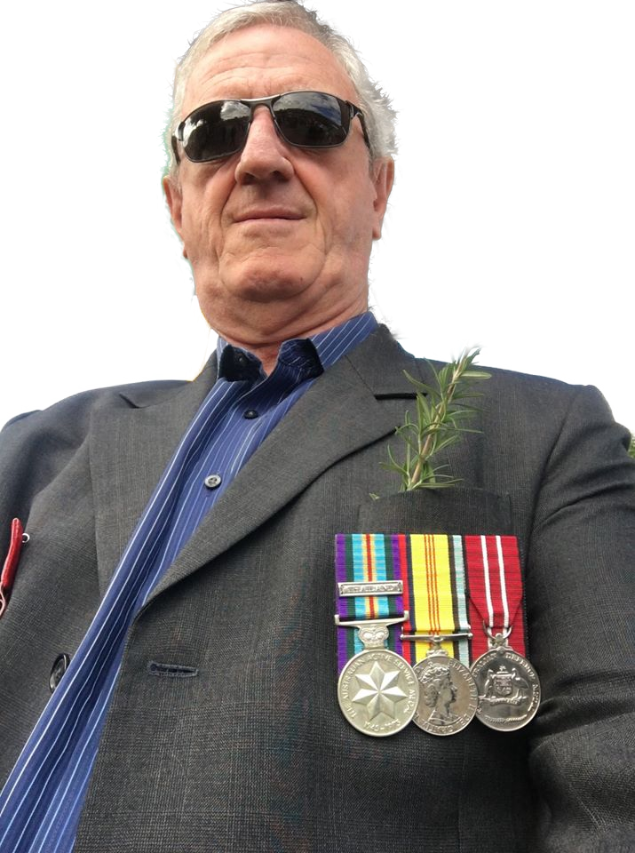
1966: The politicians forced our young men and women into a war we didn’t want!
2: Thousands of our young men and women were used as collateral for the loans and conscripted into the military to go and fight in the Vietnam war… a country we had no fight with.
Step 2
Mike Holt was one of those young men!

Slide 5
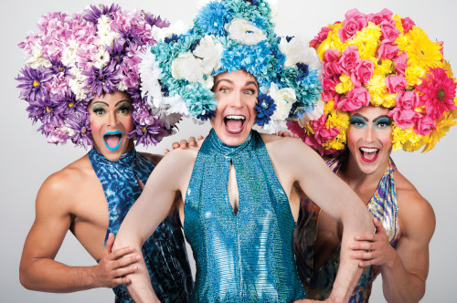
1972: EG Whitlam, a man with one share in the Commonwealth of Australia, stole the election before vote counting was finished…
He and Lance Barnard set up a Duumvirate (2 person) government and took control of all the Ministries and proceeded to make many changes to our constitutional laws.
Step 3
They amended the Royal Style and Titles Act to create the Queen of Australia????
NOT these queens!!!

Slide 6
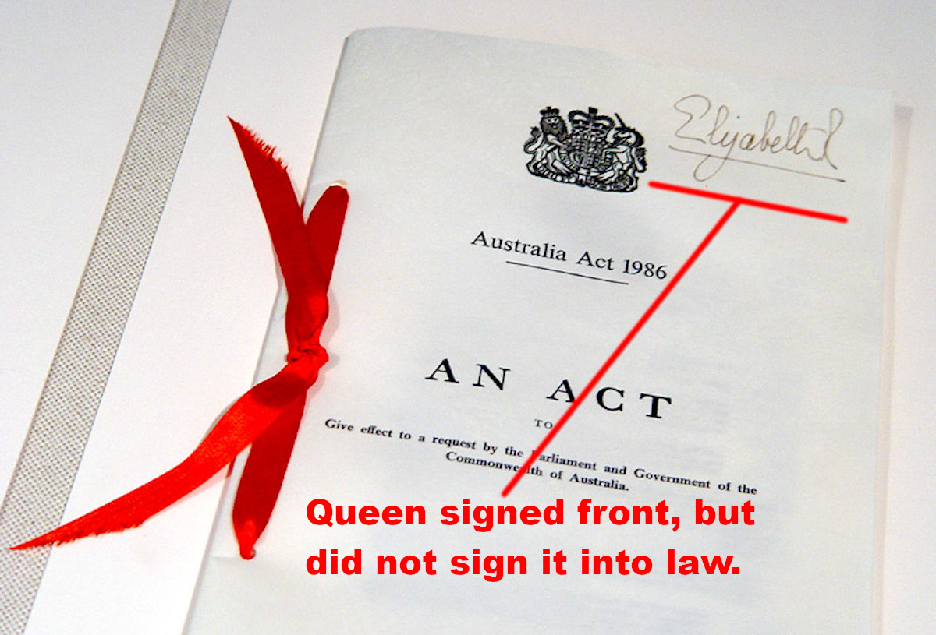
1986: Bob Hawke created the Australia Act in an attempt to sever our ties with the United Kingdom and create a defacto Communist-style Republic
He invited the Queen to sign it into law, but she refused because he did not conduct a Referendum of the people, as required in Constitution Section 128 to amend our Constitution in any way.
Step 4
Instead, she signed the front page to show that she had read it. And Bob signed it into “law” with a printed BOB HAWKE… not his real name!
FRAUD VITIATES EVERYTHING!

Slide 7
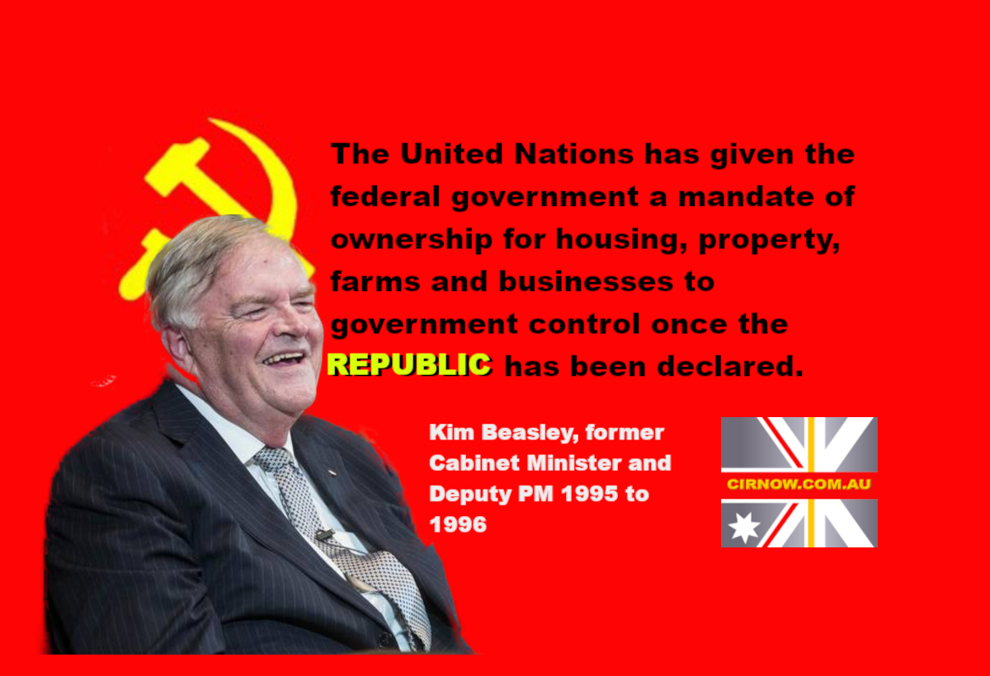
Since then, successive governments have slowly whittled away our rights and freeoms….
In 1995, Kim Beazley took ownership of ALL Australian land. You no longer own your own property! Now, they are even destroying our land titles.
Instead, they are issuing digital titles that can be easily deleted if you do not pay your Rates, or if you disobey them in any other way.

Slide 8
HOW CAN WE FIX THIS MESS THE POLITICAL PARTIES HAVE CREATED?
Our Commonwealth of Australia Constitution Act 1901 is still in place protecting us from the liars, thieves, criminals and TRAITORS!
Unite!
But it will only protect us if we UNITE and stand up together for our rights and freedoms against those who are trying to take them away.
Common Law Assemblies are springing up all over the country as more people see that only the Law will protect us.
The only true law is our Common Law!

Slide 9
What is Common Law and how can it work for you?
Put simply, Common Law, or the Law of the Land, has been used to govern and keep the peace in communities ever since humans first gathered together for their mutual protection. It is the body of law decided on by a community to govern themselves and to ensure all people can gain a remedy for any wrong done against them.
Unite!
Common law in Australia is vested in our Commonwealth of Australia Constitution Act 1901 – It is the highest law of the land.
The Constitution Preamble starts with these 3 most important words:
WHEREAS the People…
This establishes us as the Supreme Authority over the Parliament

Slide 10
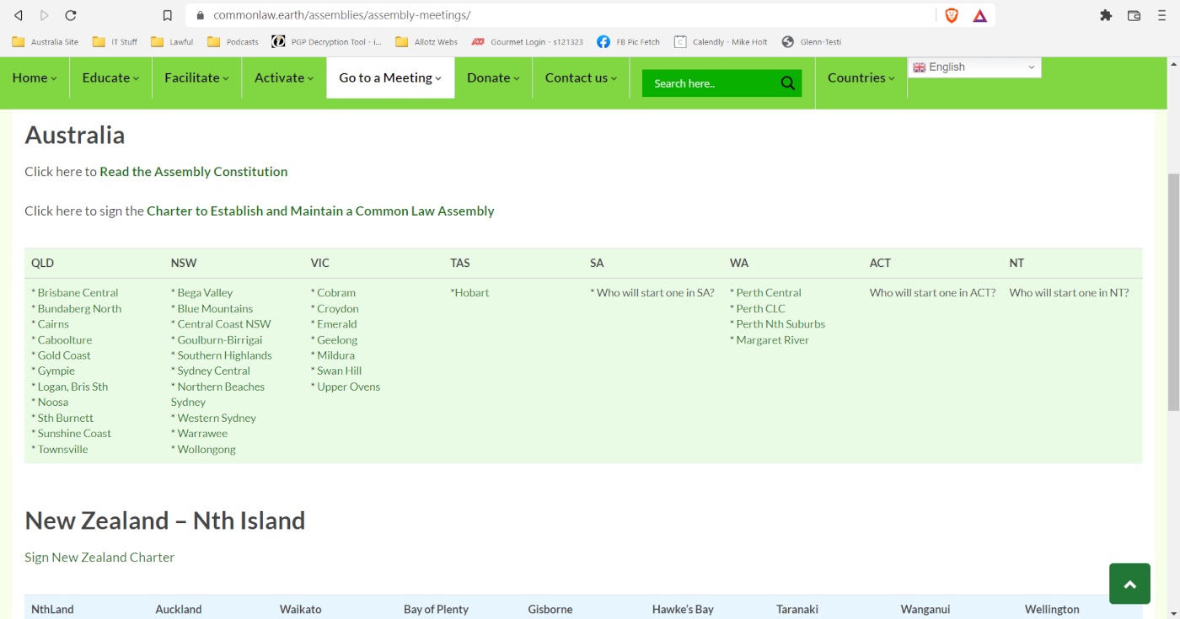

Slide 11
What is a Common Law Assembly and why should you join (or start) one?
The Oxford dictionary defines an assembly as a gathering of people who come together for a specific purpose.
Unite!
When we convene a Common Law Assembly and sign a Charter we create a government of the People, with all the powers of any government.
We can pass laws, elect our own Sheriffs, convene common law courts, and even form and maintain a local militia, trained by our Sheriffs, to protect our community from enemies…. Both within and without the country!

Slide 12
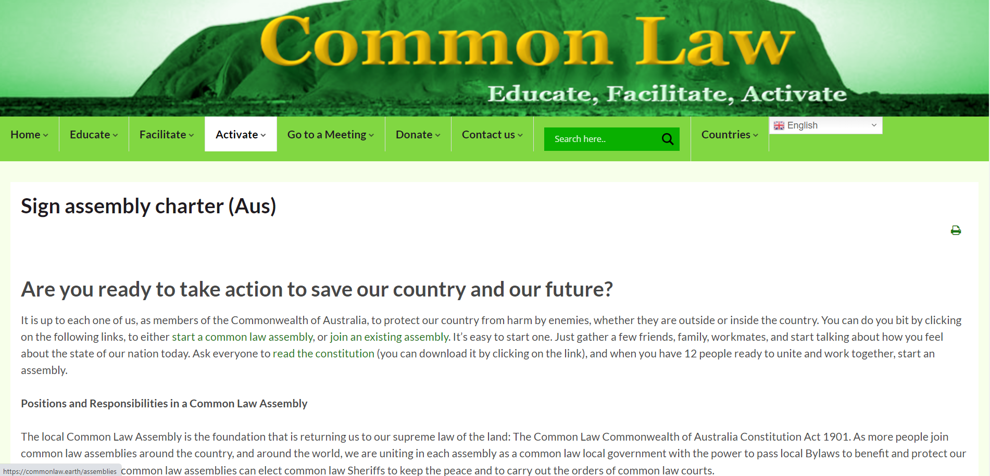
Sign a Charter here:
https://commonlaw.earth/assemblies/sign-assembly-charter-aus/

Slide 14
Only People Power will stop the fraud, crimes and TREASON against us
Each Assembly has three tasks:
Educate
Facilitate
Activate
Educate
When we know the law, we can stand up for our RIGHTS confident and empowered.

Slide 15
Only People Power will stop the fraud, crimes and TREASON against us
The government has deliberately dumbed down our education system in an effort to stop us questioning their authority. But We the People are the supreme Power over the Parliament…. NOT the other way around!
Educate

Slide 16


Slide 17
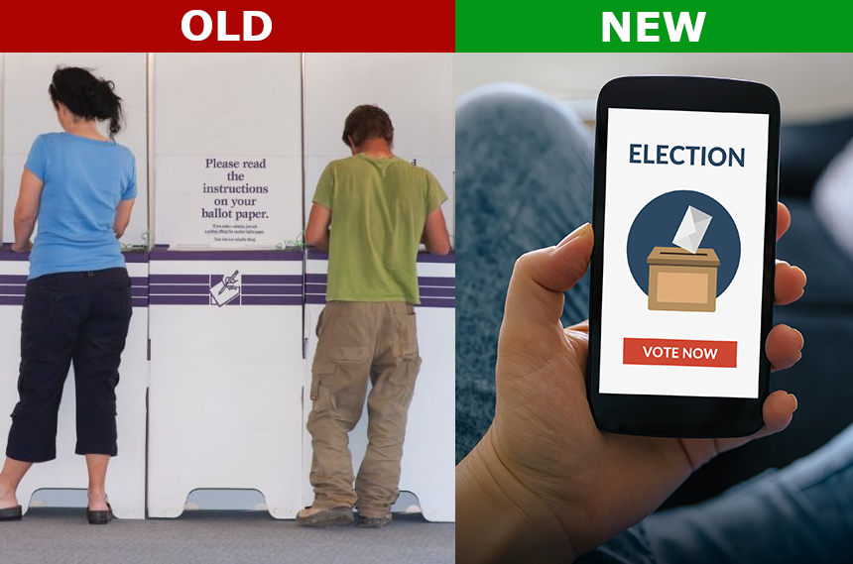
There is a Plan for the Future:
1. Amend Constitution S.128 to give all voters the right to Binding Citizens Initiated Referendums (CIR), as is our right! – and at the same time…
2. Implement a secure online voting system based on the blockchain so that voters can vote anywhere, any time, giving us a more flexible and stronger democracy. The App is ready!
The Plan

Slide 18


There is a Plan for the Future:
3. Reform the electoral system through a carefully considered constitutional referendum to reduce the size of electorates, create new Regional governments instead of State governments, making representatives directly accountable to the voters.
The Plan
If a representative does not perform their duties they can be recalled and the people can immediately elect a replacement.

Slide 19
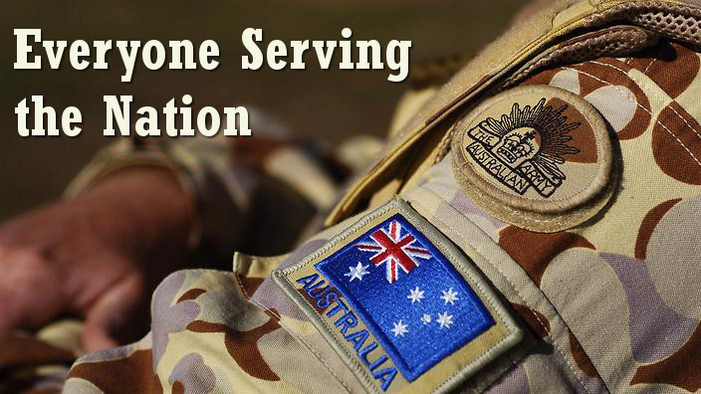
There is a Plan for the Future:
4. Reform the taxation system to bring in a single corporate bank transaction tax. Imagine no more GST, payroll, business, income, and all the other taxes…just a single tax only on companies!
The Plan
5. Implement Service to the Nation. If our country gives us so much, it’s only fair that we give something back. Those eligible to serve will be able to choose Civil or Military Service. All equipment supplied to these services must be manufactured in Australia within a time limit determined by the availability of trained people and materials. Imagine what that will do to grow our economy!

Slide 20
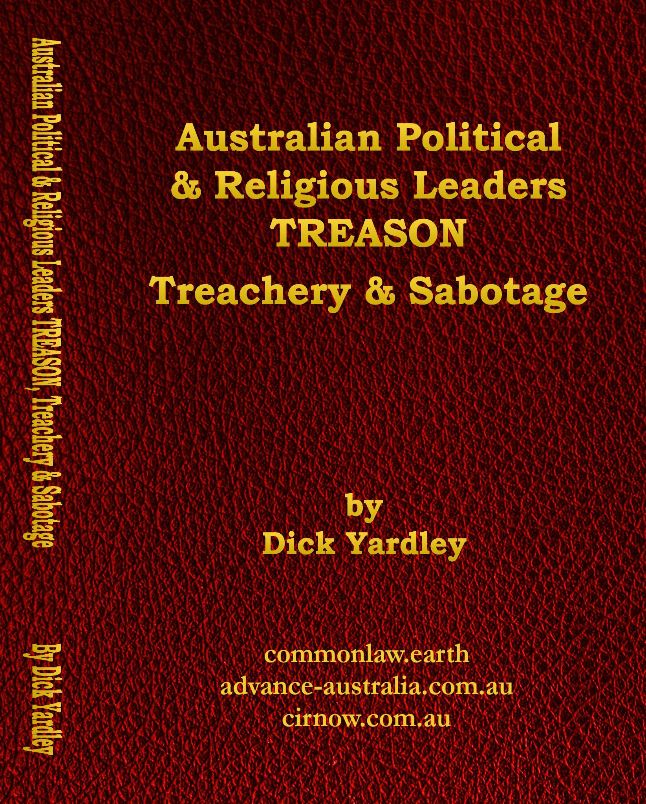
What YOU can do right now:
Educate yourself about Common Law and your rights. It’s all available on the website: www.commonlaw.earth
Join an assembly near you. You will meet many others working to change the political and social system to create a better future…
Activate!
If there is no assembly near you, why not start one yourself? It’s easy. Just follow the To Do guide here:
https://commonlaw.earth/assemblies/start-assembly-to-do-list/
Get Dick Yardley’s book that documents all the crimes, treachery and TREASON the political parties have committed.
https://advance-australia.com.au/product/buy-dick-yardleys-book/

Slide 21
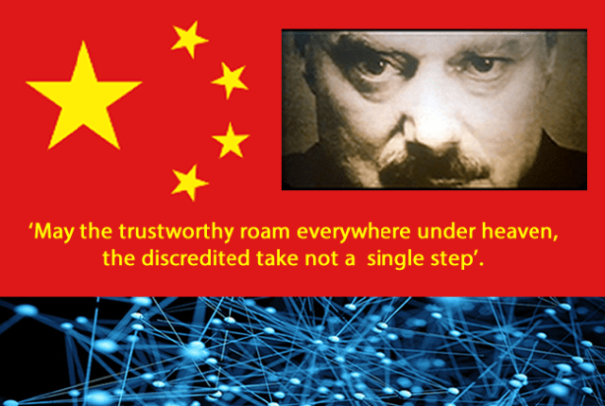
What Corona is really about:
The Chinese Communist Party implemented a savage Social Credit system just before the outbreak of the Corona panic.
They are using the 5G mobile system to monitor the movement of every person in China. Everywhere the people go the Chinese people must carry a Social Credit passport (sound familiar?).
If they do not obey their every command the CCP immediately fine them, and they lose points from their social credit score

Slide 22
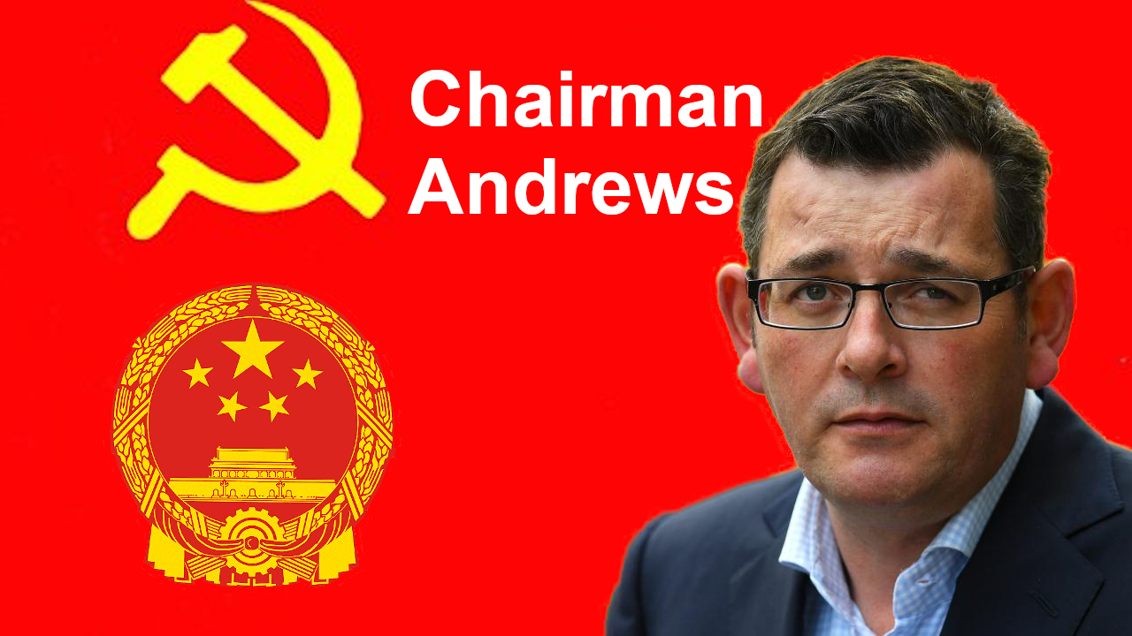
What Corona is really about:
When they lose all their points they become a pariah, unable to travel, shop, or work.
Once that happens, they are arrested and placed in a ‘re-education camp’.
The Queensland government is already building ‘quarantine camps’… another name for Nazi-style internment and extermination camps!

Slide 23
Our Constitution is the highest law of the land. It was designed to protect our Common Law Rights
Clause 5: This Act, and all laws made by the Parliament of the Commonwealth under the Constitution, shall be binding on the courts, judges, and people of every State and of every part of the Commonwealth, notwithstanding anything in the laws of any State;
The Law
Section: 109. When a law of a State is inconsistent with a law of the Commonwealth, the latter (Federal) shall prevail, and the former (State) shall, to the extent of the inconsistency, be invalid.

Slide 24
Our Constitution is the highest law of the land. It was designed to protect our Common Law Rights
The 1946 Referendum that amended Section 51 (xxiiiA) denies Government the power to force any medical regime on us. It states…
The Law
51 (xxiiiA) the provision of maternity allowances, widows’ pensions, child endowment, unemployment, pharmaceutical, sickness and hospital benefits, medical and dental services (but not so as to authorize any form of civil conscription), benefits to students and family allowances;

Slide 25
We are also protected by other Federal Laws
The Privacy Act 1988 Section 94H (2) A person commits an offence if the person:
(a) refuses to enter into, or continue, a contract or arrangement with another person (including a contract of employment); or
(b) takes adverse action (within the meaning of the Fair Work Act 2009) against another person; or
(c) refuses to allow another person to enter:
(i) premises that are otherwise accessible to the public; or
(ii) premises that the other person has a right to enter;
The Law
Penalty: Imprisonment for 5 years or 300 penalty units ($63,000), or both

Slide 26
We are also protected by other Federal Laws
The Privacy Act guarantees our right not to reveal our medical status:
This includes:
The Right to refuse to answer any questions about our medical status
The Right to choose whether to medicate or not
The Right to enter any premises providing medical services for treatment of any illness or disability
The Law

Slide 27
We are also protected by other Federal Laws
DISABILITY DISCRIMINATION ACT 1992 - Commonwealth Consolidated Acts (LAW)
DISABILITY DISCRIMINATION ACT 1992 - SECT 23
Access to premises
It is unlawful for a person to discriminate against another person on the ground of the other person's disability:
(a) by refusing to allow the other person access to, or the use of, any premises that the public or a section of the public is entitled or allowed to enter or use (whether for payment or not); or
(d) by refusing to allow the other person the use of any facilities in such premises that the public or a section of the public is entitled or allowed to use (whether for payment or not);
The Law
Penalty: six months imprisonment (s. 42)

Slide 28
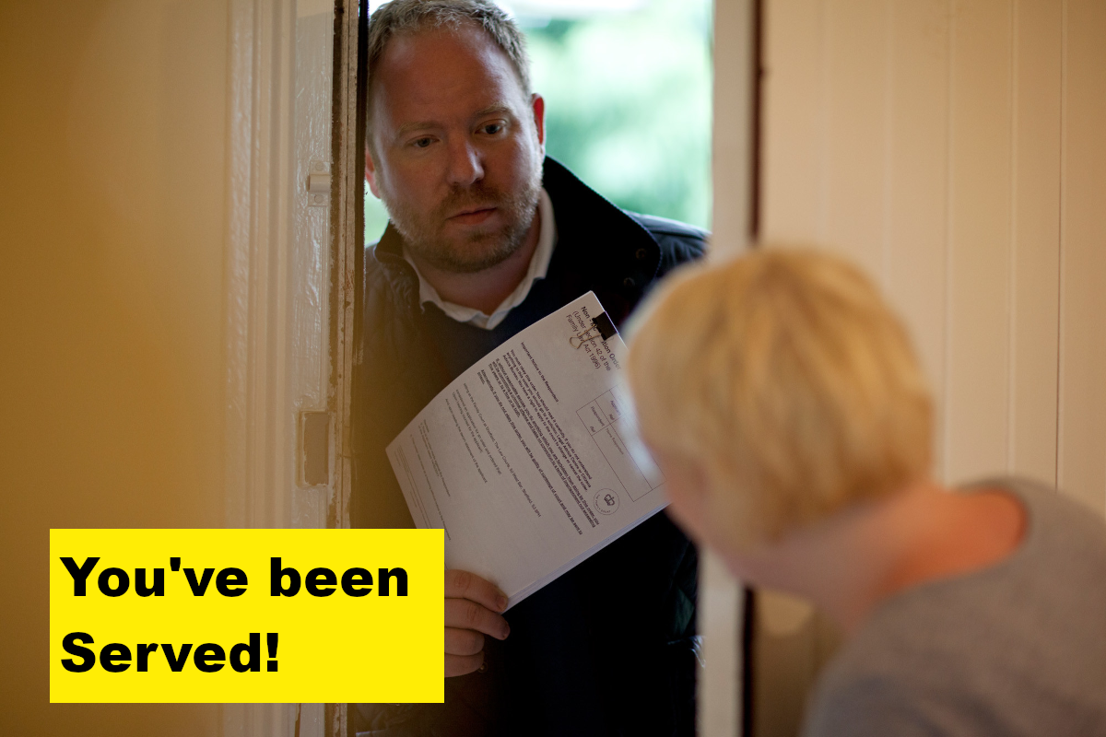
Action to take:
The government is breaking several Constitutional and Federal laws.
By forcing businesses to comply with the Covid mandates, the two most important laws they are breaking are the Constitution Section 51 (xxiiiA), and the Privacy Act Section 94h.
We can use them to protect ourselves.
Because businesses don’t know the law they think they are doing the right thing when they refuse you entry to their premises.

Slide 29
Action to take:
If you show them the laws they are breaking and they continue to impose the restrictions because they are afraid of getting fined, explain to them that the penalties for breaking Federal Laws are much harsher and could result in them being jailed and fined heavily.
If they ignore your warnings, then it’s time to serve them a summons to court.

Slide 30
Action to take:
These are the steps you can take:
Get the name, date of birth, and any other details about the person refusing you entry.
Go to this website (write it down now):
https://cirnow.com.au/how-to-take-a-business-to-court/
Follow the steps and download the documents provided.
It’s easy to do. Once you charge someone with a crime it’s up to them to defend themselves in court. We need to take them to court to establish a precedent.

Slide 31

Action to take:
Learn how at:
https://cirnow.com.au/how-to-take-a-business-to-court/
Do not be afraid to summon them to court.
In fact, it is your DUTY to take action when you see someone breaking the law!

Slide 32
Action to take:
If you need help preparing the court documents contact me at mikeh@commonlaw.earth and our lawyer will guide you.

Slide 33
What about the future?

Slide 34
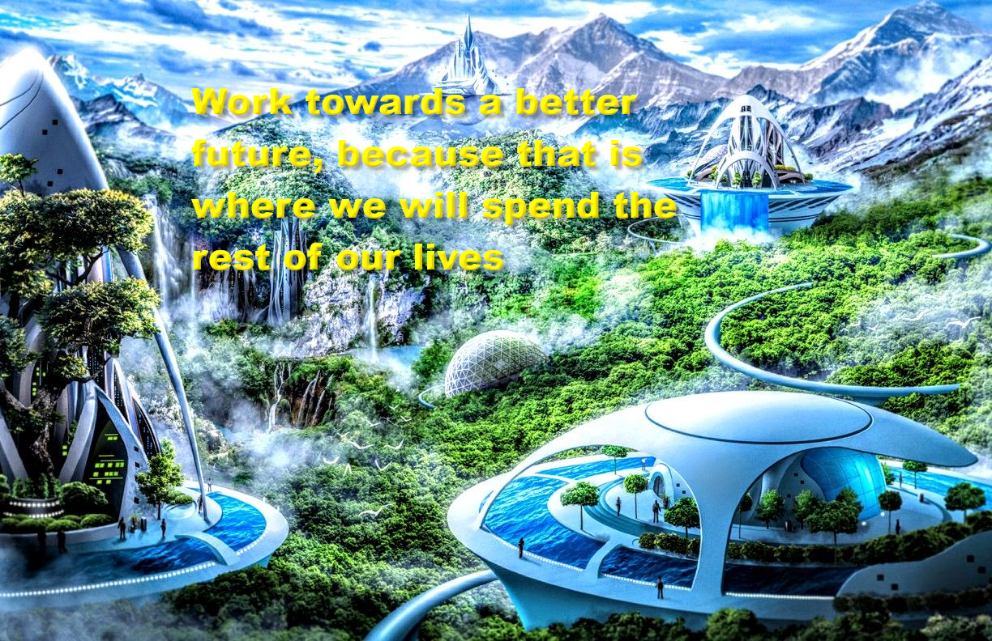

Slide 35
What will a future in Common Law look like?
For centuries we have been told what to do, when to do it, how to do it, and why we have to do it. We have not been able to exercise our own free will.
The Future!
For many, the future will be a scary place… for a while.
But once we take those first tentative steps towards living our lives as free, independent, responsible people we will lose the fear of the unknown.
Who doesn’t want to throw off the chains the political party corporate governments have ensnared us in for so long?
Who doesn’t yearn to be able to make decisions for our life and our family without wondering how, or even IF, we can do it?

Slide 36
So, what sort of future can we look forward to?
As we saw in the 5-Step Plan, we will be able to take an active part in deciding what sort of society we want to live in.
The Future!
Our representatives will be directly accountable to us.
We will tell them what we want, and if they do not deliver we will recall and replace them.
No more broken election promises.
No more wasteful projects that benefit only a select few.
We will work together to decide on the type of community we want to build

Slide 37
So, what sort of future can we look forward to?
We could finally enjoy the great wealth of our nation. In a recent study, we found that Australia has mineral reserves worth Trillions of dollars!
We could rebuild our manufacturing, farming, and social fabric to benefit all Australians
The Future!
We could review and streamline our laws so that they benefit us, instead of restricting us. At the same time, we could ensure that those who are a danger to society are no longer a threat to our safety and security.

Slide 38
So, what sort of future can we look forward to?
We could build a strong nation, capable of defending our land while building strong trading and social ties with our neighbours, so that we can all live in peace.
The Future!
Because only corporations that create value would pay taxes, we could enjoy the fruits of our labour to the full!
Instead of a nation living in fear of invisible health threats, we could encourage people to live a healthy and happy lifestyle.

Slide 39
The Future is Ours
Let’s make our future one we can be proud of…. A future our children will enjoy for generations to come.
The Future!
It’s your choice. Are you ready to unite and work to create the kind of country we will all want to love and protect?
Join or start a Common Law Assembly now and let’s get started!

